Slide 1

Visualization for the Web

Slide 2
Why the web??
Notes:
Web browsers have turned out to be powerful front ends for the creation of graphics, and in particular enable interactive graphics.
They perform cross-platform, work with raster and SVG, etc. (imagine, we could do data viz in Swift!).
Heck, jupyter has realized that web browsers provide a front end that is easier to work with than QTK.

Slide 3
Friends

Slide 4
Friends

Slide 5
Friends

Slide 6
Friends

Slide 7
Friends

Slide 8
Friends

Slide 9
Fundamentals
HTML
CSS
JS

Slide 10
Fundamentals
The DOM
Notes:
stored internally in the browser using a document-object-model

Slide 11
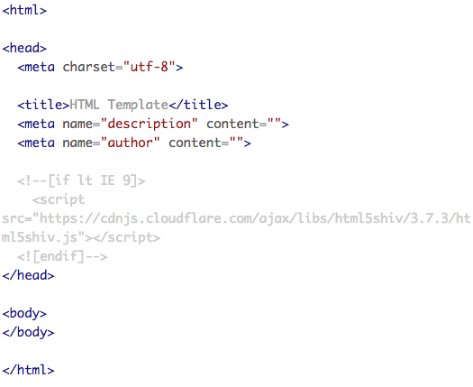
HTML

Slide 12
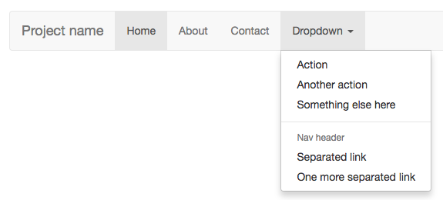
CSS
Notes:
https://getbootstrap.com/examples/navbar/

Slide 13
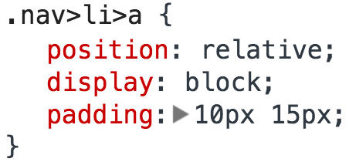
CSS

Slide 14
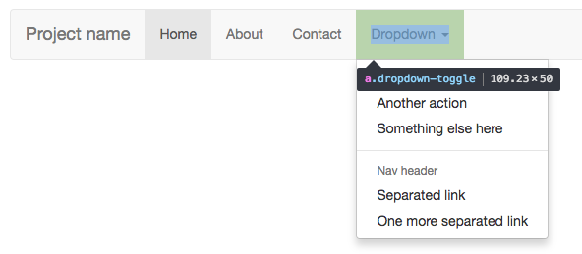
CSS

Slide 15
Javascript
Javascript is a dynamic programming language that can bring interactivity to websites (and other things).
Note: It’s not actually a subset of Java (it comes from ECMAScript standard, still called this sometimes (e.g., ES 6 is next)).
Also, it’s everywhere.

Slide 16
So What Can You Do With It?
Well, pretty much anything. OK, maybe not anything,…but close.
A few examples: responses to when buttons are pressed or when data have been entered on forms, animations, games, dynamic styling,
…and so much more.

Slide 17
The NPM repository has 228K different packages, from webservers to package managers to “yo: CLI tool for running Yeoman generators” (npmjs.org)
Combined with Chromium Core, can even build cross-platform desktop apps!

Slide 18
Let’s Load a Web Page
…in slow motion!

Slide 23
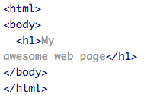

Slide 24


Slide 25
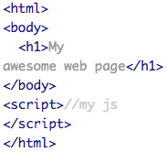

Slide 27
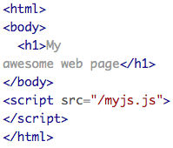

Slide 28
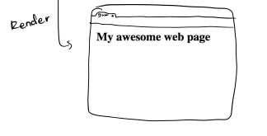

Slide 32


